Slide 1



Slide 2
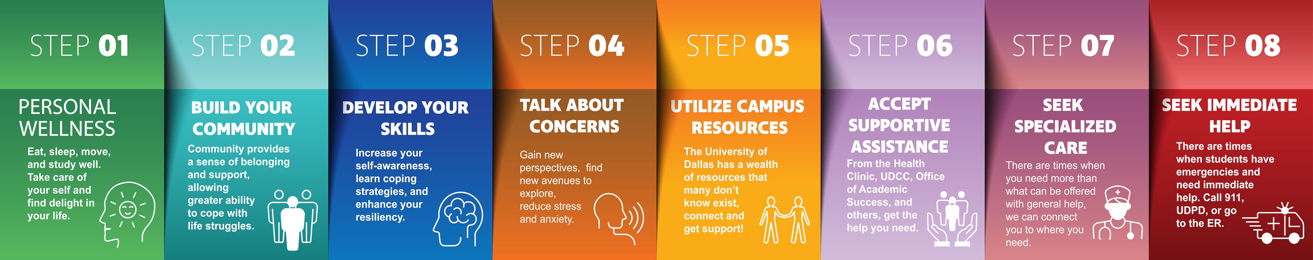
STEP TOWARDS WELLNESS.

Slide 3
Our WELLNESS MAPPING STEPS Initiative, a whole-campus initiative guided by Catholic Christian Anthropology for the dignity of the whole person, is an adaptable sequential model that prioritizes the support of all students, not just those at the forefront. This model is not a clinical panacea or a trademarked cure-all program. It offers pathways towards wellness, utilizing a variety of resources, ensuring that everyone can meet their unique needs.

Slide 4
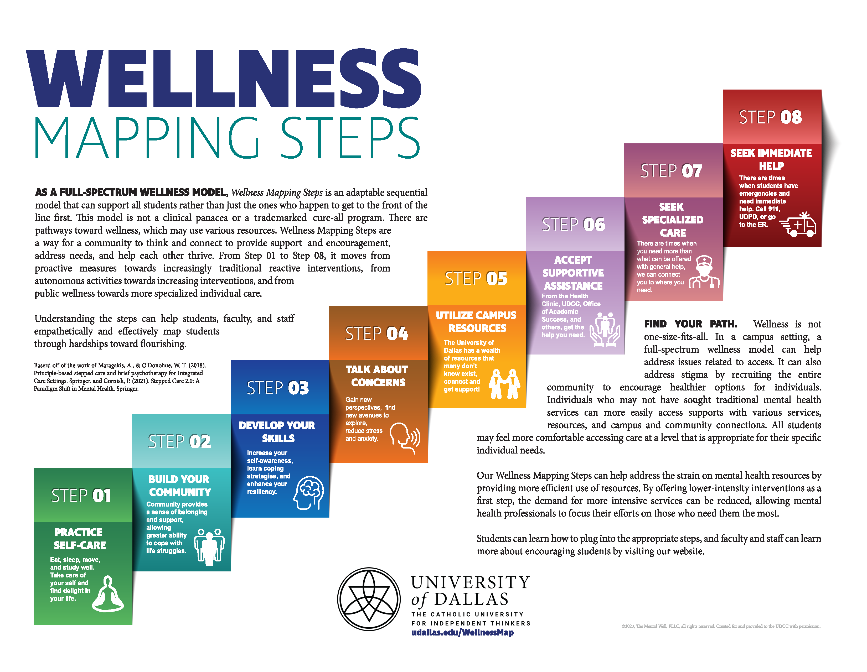
Public Health & Wellness Initiatives
Helping Students Thrive
Supporting Students in Distress
The University of Dallas constantly seeks ways to prepare students for life and work in a problematic, changing, and challenging world. UD has a pathway for every student.

Slide 5
Contact our Case Manager for more support.
WELLNESS MAPPING STEPS are a collaborative approach to thinking and connecting in a community. The model provides support and encouragement, addresses needs, and allows us to help each other thrive.
From Step 01 to Step 08, it progresses from proactive measures towards increasingly traditional acute interventions, from autonomous activities towards increasing interventions, and from public wellness towards more specialized individual care.
Understanding the steps empowers students, families, faculty, and staff to empathetically and effectively map students through hardships toward flourishing.

Slide 6



Slide 7

Our Wellness Mapping Steps are designed to alleviate mental health resources' strain by using pre-existing resources more efficiently.
By offering lower-intensity interventions as a first step, we can reduce the demand for more intensive services, allowing mental health professionals to focus their efforts on those who need them most.
This approach ensures that every resource is utilized effectively, instilling confidence in the model's effectiveness.

Slide 8
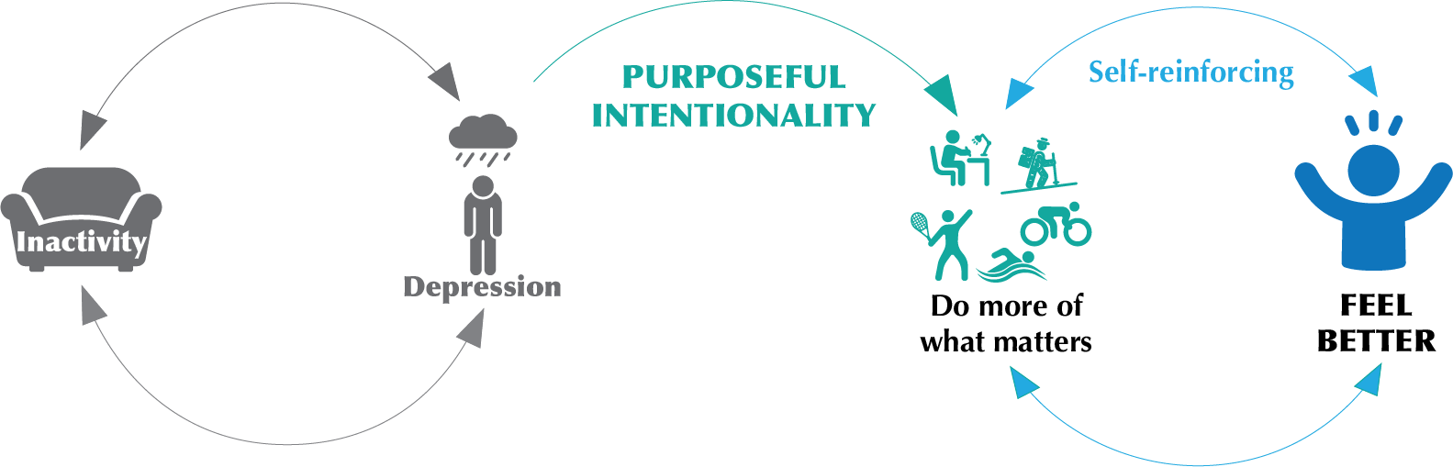
Purposeful intentionality is putting forth efforts to be consciously aware and deliberate in one's actions and thoughts and discerning through decisions.
This concept is crucial for individuals to promote focus, clarity, and goal-directed behaviors. It is a psychological tendency to derive meaning from experiences and possess a sense of goal-directedness that guides behaviors that help support overall wellness.
This intentional approach allows individuals to be more present, focused, and purpose-driven, leading to enhanced cognitive performance, personal growth, and overall well-being. Let’s examine the steps you can take to achieve Purposeful Intention.
**Life isn’t always this easy. If you need additional support or help, contact us for further assistance.
PURPOSEFUL INTENTIONALITY

Slide 9
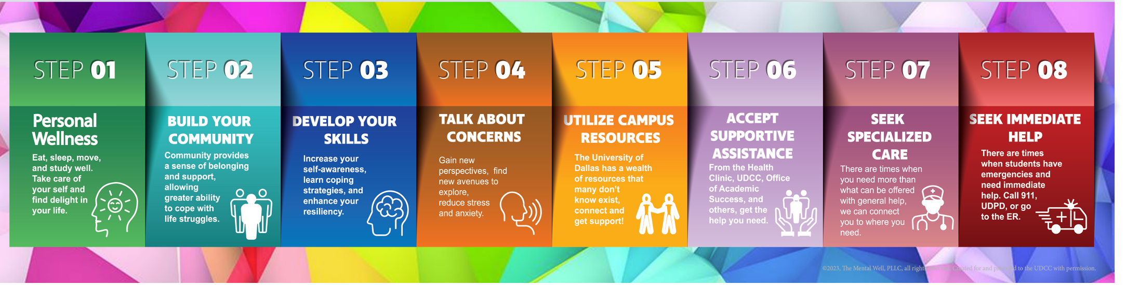
A basic wellness screen can help you identify potential health concerns and points of improvement and recognize the good points you already possess. It's a proactive way to ensure that you're taking care of your overall well-being, which is especially important during the demanding and stressful college years. Below is your free and confidential tool to enhance and improve your own well-being through self-awareness and tailored feedback
Take the Basic Wellness Screen
Or, keep exploring.
Click on an option to learn more.

Slide 10

AND NOW…
FIND YOUR STEP!
Click on a step to learn more.
Contact our Case Manager if you have more questions or need assistance

Slide 11


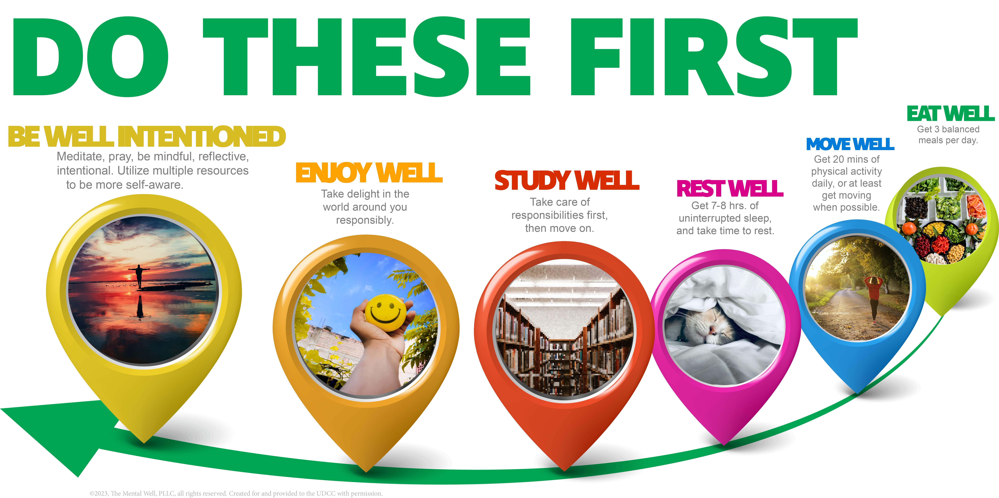
Back to ALL STEPS
Eat, sleep, move, and study well. Take care of yourself and find delight in your life.
Personal well-being practices improve quality of life by fostering positive emotions, satisfaction, and happiness: True self-actualization, building resilience, nurturing deep friendships, and learning to live fully. By being Purposefully Intentional, these practices encompass various aspects of life, including social relationships, physical health, and emotional well-being, all vital for a fulfilling life.
Contact our Case Manager for more support.
Click here to see more.
Jump to End.
Notes:
Sometimes the first step of a journey is the hardest to take.

Slide 12







Back to ALL STEPS
Community provides a sense of belonging and support, allowing greater ability to cope with life struggles.
Contact our Case Manager for more support.
Click here to see more.
And
Much
More!
Love ye UD!
Jump to End.

Slide 13

Back to ALL STEPS
Increase your self-awareness, learn coping strategies, and enhance your resiliency.
Contact our Case Manager for more support.
Developing self-awareness, coping strategies, and resilience is an ongoing process that requires Purposeful Intentionality. Incorporating these skills into your daily life can enhance your ability to overcome challenges, build stronger relationships, and cultivate a greater sense of well-being. Remember that this step is self-led, so be patient with yourself and celebrate your progress along the way. If you need more support, there are more steps to take!
Click here to see more.
Purposeful Intentionality requires individual effort to learn and grow. If you can learn and grow independently, there are countless resources, books, videos, websites, programs, supports, courses, etc. Try looking into some of these resources; you may be surprised. It only requires you to get the ball rolling and focus on your future success. If you need some direction to focus, we can help point the way.
Jump to End.

Slide 14

Back to ALL STEPS
Gain new perspectives, find new avenues to explore, and reduce stress and anxiety.
Contact our Case Manager for more support.
Opening up about your concerns in college is not a sign of weakness but rather a courageous step toward self-awareness and growth. By sharing your worries with others, you can gain new perspectives, explore new avenues, and reduce stress and anxiety. Remember that you're not alone; seeking support is a sign of strength, not weakness.
Click here to see more.
There are too many to list here. UD is full of dedicated and caring people who help you succeed, including family, Peers, Faculty, Staff, OSL, RAs, RCs, the Chaplain, Campus Ministers, FOCUS Missionaries, Cistercians, Dominican Men and Women, etc. Even the grounds crew have been seen resting their chins on a shovel while talking to students.
Jump to End.

Slide 15

Back to ALL STEPS
The University of Dallas has a wealth of non-clinical resources that many don’t know exist. Connect and get support!
Contact our Case Manager for more support.
UD provides a variety of free resources and support services to help you succeed academically, professionally, and personally. Make sure to explore the available resources and reach out for assistance when necessary. Whether you need academic support, career guidance, mental health services, or financial aid, your campus is here to support you on your journey to success.
Click here to see more.
Tutoring, Writing Lab, Coaching, & more
And
Many
More!
Jump to End.

Slide 16


Back to ALL STEPS
From the Health Clinic, UDCC, Office of Academic Success, and others, get the help you need.
Contact our Case Manager for more support.
Click here to see more.
And
More!
Jump to End.
Notes:
**UD Health Insurance provides free virtual therapy sessions with therapists off campus.

Slide 17









Back to ALL STEPS
There are times when you need more than what can be offered with general help, we can connect you to where you need.
Health Systems* a short drive from UD:
Contact our Case Manager for more support.
Click here to see more.
And Many
More!
*For information only. UD is not affiliated in any way with any of the above-listed health systems.
Jump to End.
Notes:
Navigating the

Slide 18

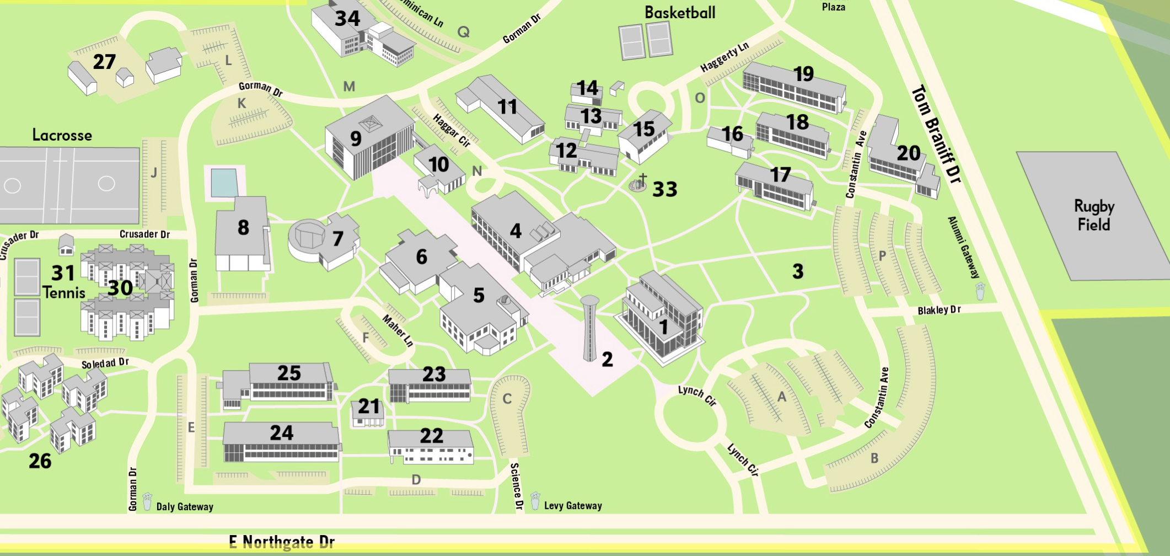
Back to ALL STEPS
There are times when students have emergencies and need immediate help. Call 911, UDPD, or go to the ER.
udallas.edu/red-folder.php
See the UD
RED FOLDER for more info…
Counseling Center and Health Clinic are located upstairs in Haggar, #4.
Dean of Students is located on 1st Floor of Haggar, #4.
UDPD is located in the back of Blakely Library, #10.

Slide 19
CONCLUSION
The WELLNESS MAPPING STEPS Initiative stands as a beacon of holistic support within our campus community, grounded in the profound principles of Catholic Christian Anthropology. It embraces diversity and individuality, recognizing that wellness is a journey unique to each person. Rather than heralding a one-size-fits-all solution, this initiative provides a community-based framework for exploration and empowerment, offering diverse pathways toward wellness. By prioritizing the dignity of every individual and fostering a culture of inclusivity, tenants of the University of Dallas, as a Catholic university for independent thinkers, the model endeavors to cultivate a campus environment where all members can thrive, embodying the essence of holistic well-being.
We’re here to walk alongside you as you take your step toward wellness. Whether self-led, supported by the community, or looking off-campus, UD is here for you.
Contact our Case Manager for more support: counseling@udallas.edu • 972-413-8016.

Slide 20

©2024 University of Dallas. All Rights Reserved.
counseling@udallas.edu • 972-721-4045
1845 E Northgate Dr, Haggar 340
Irving, TX 75062
Wellness Mapping Steps Material © 2023, The Mental Well, PLLC. All Rights Reserved.
Used with Permission.
Wellness Mapping Steps, based on the Stepped Care Health Delivery Model.
Photo Credits
Matt Foxx on Unsplash
Helena Lopes on Unsplash
Christopher Burns on Unsplash

